Slide 1

CAPSTONE
PROJECT
MODULE ONE
STORE MANAGEMENT SYSTEM
KEVIN RIO HARRISTYANDO

Slide 2

Problem Statement
Managing inventory and handling payments in a store can be inefficient with manual processes. This leads to inaccurate stock levels, delayed restocking, and errors in payment tracking.

Slide 3
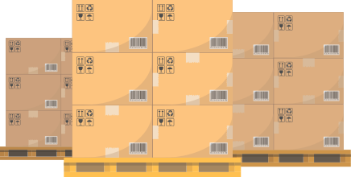

Computer Store Management System
Administrator
Monitor and manage product stock
User
browse available products
and purchase products

Slide 4
Admin Features
1
2
Add an item or Category
3
4
Display Stock Data
Update an Item
Delete an Item or Category
Display Specific Category
Display All Data
Add new product
Add new category
Update Product Name
Update Quantity
Update Unit Price
Delete an entire category
Delete an Item
User Features
1
Display available product
2
Purchase/Buy Products
Display Specific Category
Display All Data
Purchase product
Payment process

Slide 5
Data Structure
Using Nested Dictionary, with key is category product, and inside that there’s several key nested dictionary that contains product id, item name, quantity, and unit price
For the value, it sets in list data types, to make it more easier to do indexing to access the data

Slide 6
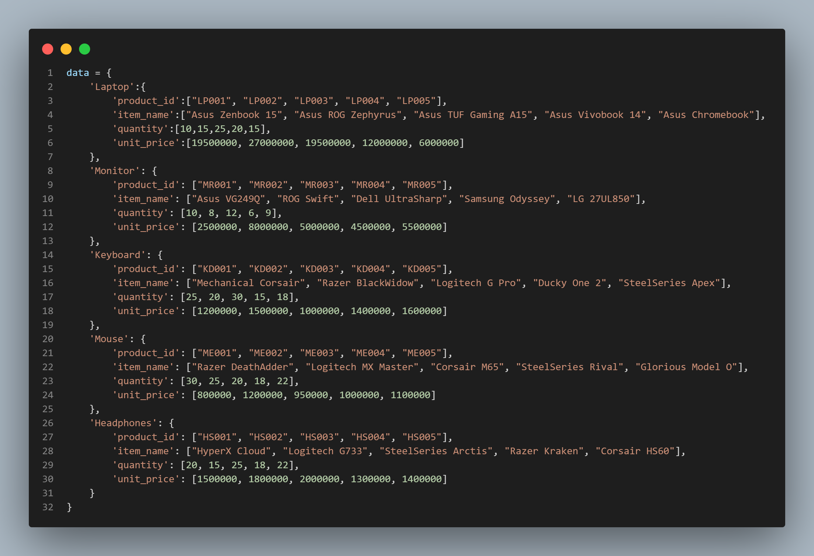
Initial Store Data
Using Nested Dictionary, Because it can simplified indexing to access several items, clear representation of each data relationship, and make it easier to read.
Key Dictionary:
Laptop
Monitor
Keyboard
Mouse
Headphones
Key Nested Dictionary:
product_id
item_name
quantity
unit_price
The value that I used is a collection data type within a list, as it makes indexing easier to access the value.

Slide 7
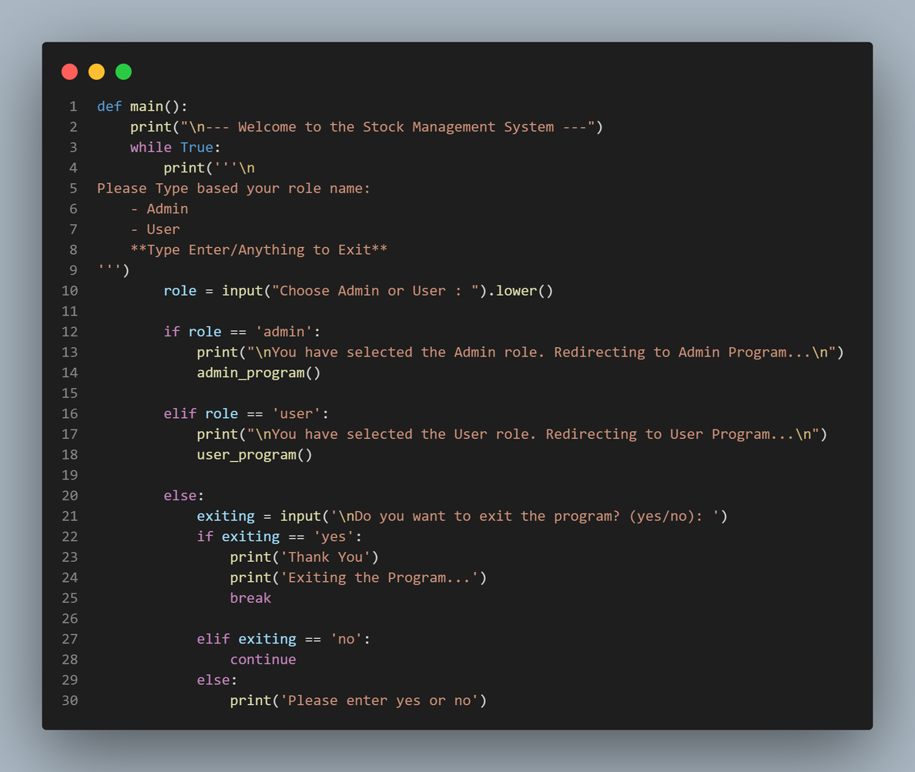
Main Program
While True Loop, keeps the program running in an infinite loop until it encounters a break statement.
Role Input, Input can be Admin, User, or other (For Exit)
Checking if Role matches “admin”, Execute the admin_program
Checking if Role matches “user”, Execute the user_program
Exit Condition,
If the input is anything other than “Admin” or “User”, It will break the infinite loop.
The program will ask for confirmation before exiting to prevents accidental exits due to incorrect input.

Slide 8
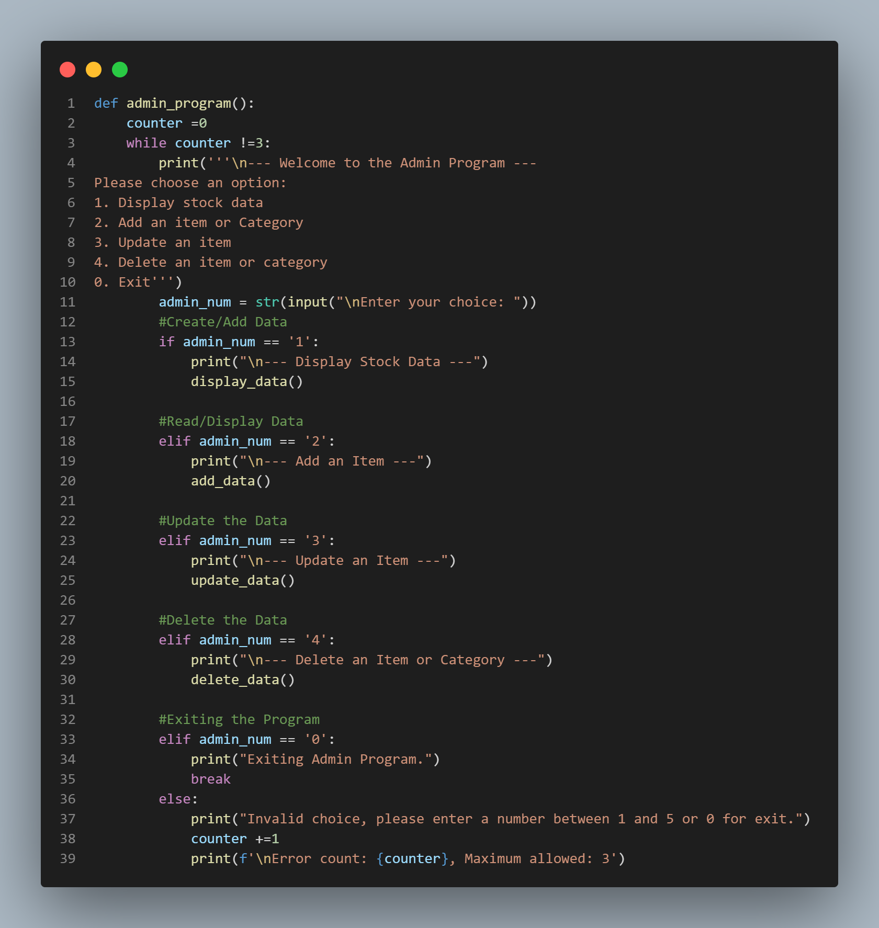
Admin Program
Initialize counter = 0
While Loop with Condition, keeps the program running until the value counter = 3.
Admin_num Input, Input can be 1-4 to run specific admin feature, or 0 to exit
If the Admin_num = 1, It will execute display_data function
If the Admin_num = 2, It will execute add_data function
If the Admin_num = 3, It will execute update_data function
If the Admin_num = 4, It will execute delete_data function
If the Admin_num = 0, It will instantly break the while loop
Exit Condition using counter,
It will add the counter value into +1, whenever the condition is met

Slide 9
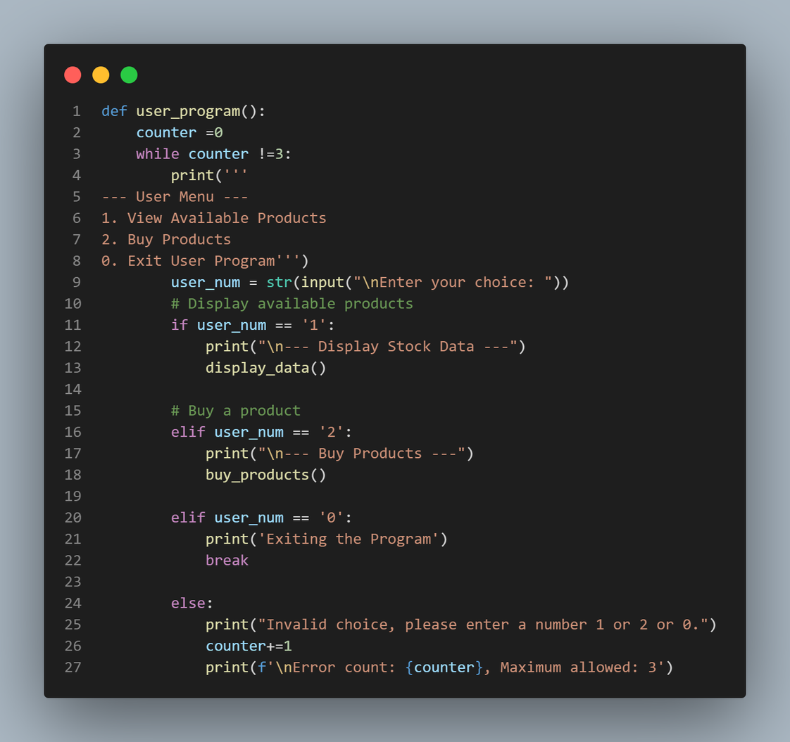
User Program
Initialize counter = 0
While Loop with Condition, keeps the program running until the value counter = 3.
User_num Input, Input can be 1-2 to run specific admin feature, or 0 to exit
If the User_num = 1, It will execute display_data function
If the User_num = 2, It will execute buy_products function
If the User_num = 0, It will instantly break the while loop
Exit Condition using counter,
It will add the counter value into +1, whenever the condition is met

Slide 10
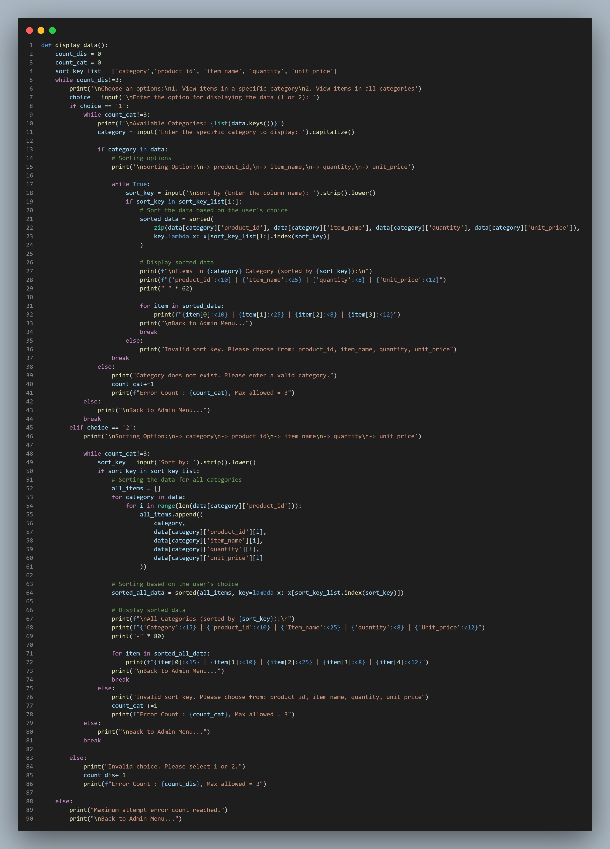
Read Data (1)
Read Data Options:
Display Specific Category
Display all categories
If the choice = 1, Display Specific Category:
Prompt the Admin or User to enter the category name to be displayed.
Verify if the category exists in the dataset:
If yes, Continue to do sorting
If no, re-enter the category name
Sort Data:
Gather the all column in data into a list by using zip function.
Use the sorted function with the specified sort_key (the name of the column to sort by).
Display the sorted data

Slide 11
Read Data (2)
If the choice = 2, Display All Data:
Asking admin or user sorting data based on what column
Collect all columns from the dataset into an empty list using the append function.
Use the sorted function with the specified sort_key (the name of the column to sort by).
Display the sorted data
Exit Scenario using counter

Slide 12
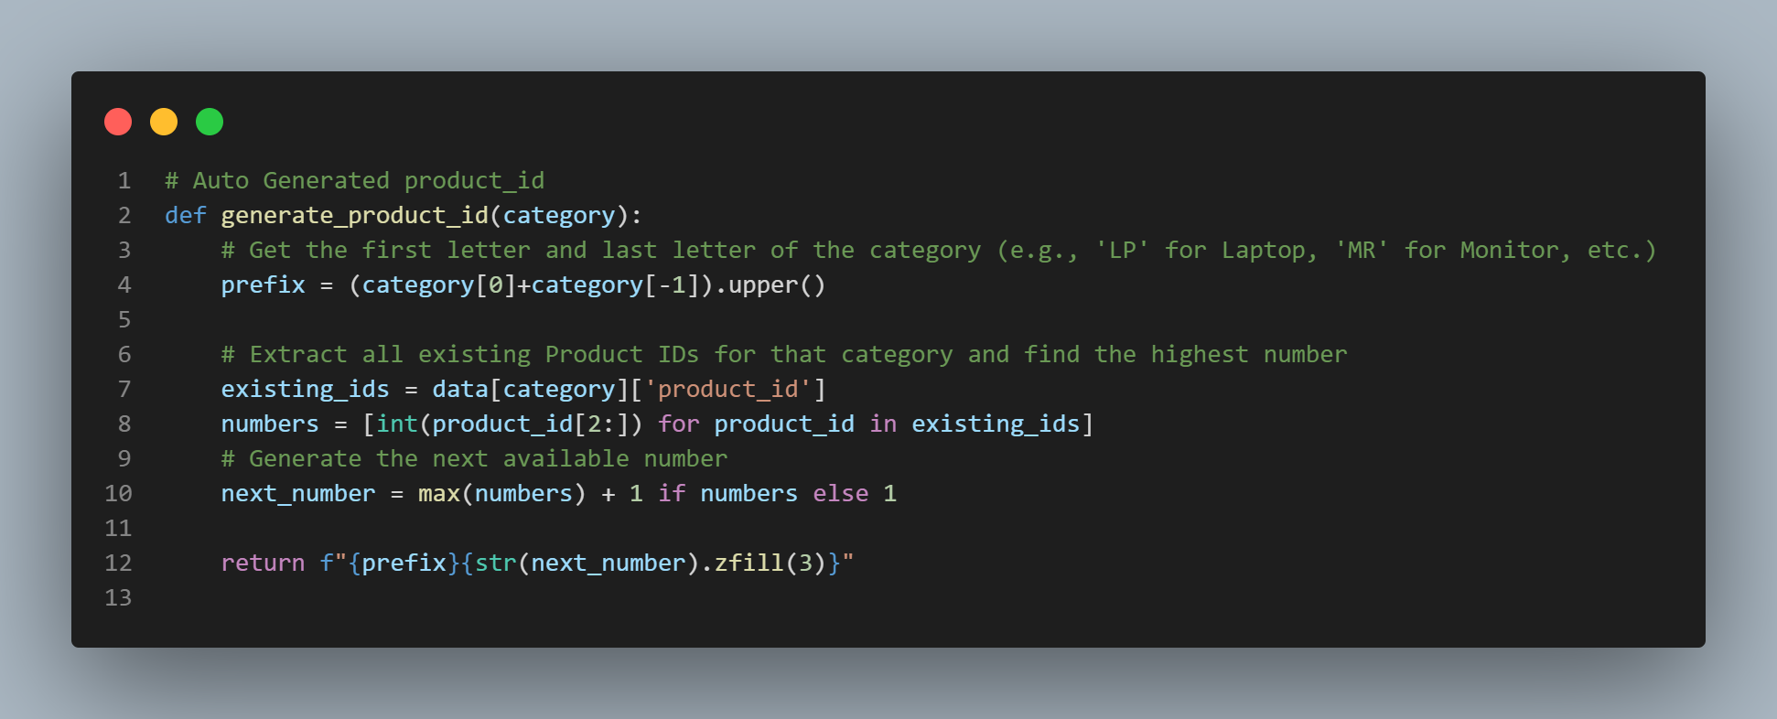
Auto Generated Product Id
Taking the first letter and last letter in category name
Accessing the product_id for that specific category
Making a list of several number of the product_id
Adding +1 from the max numbers, but if the number is None it will assign into 1
It will return value in the format “First letter and last letter of the category” + Next number,
The str.zfill(3) function is used to add leading zeros to the number, ensuring it is three digits long.

Slide 13
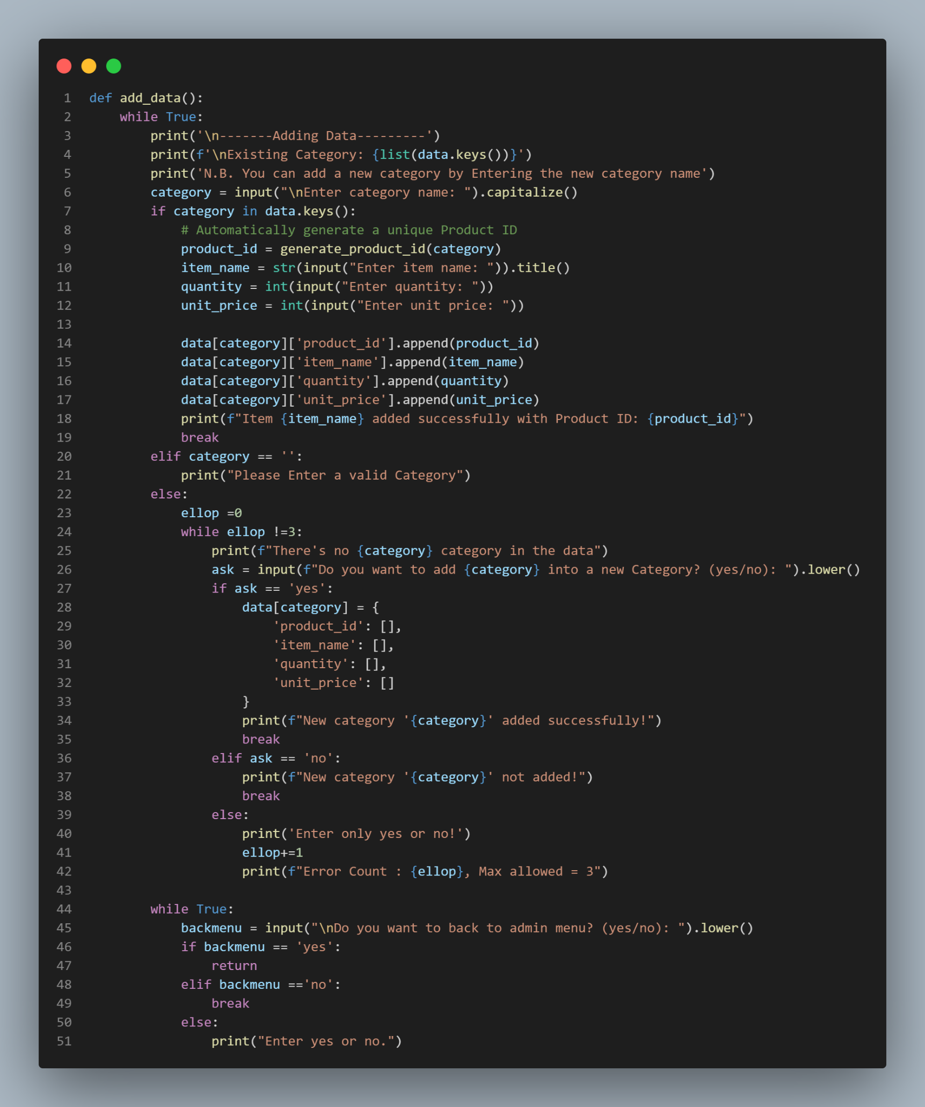
Add Data
Category Input, Input the category to access it
Auto Generate the product_id, by execute the previous
generate_product_id function
Input the necessary value for new item data, such as item_name, quantity, unit_price
Append all the inputs and generated values above into the data, indexing by the specific category and column.
If category is not in data, program will ask if admin want to add a new category
If the answer is yes, Create a new key dictionary and also the key nested dictionary that contains an empty list, and then break the loop
Exit Scenario, By Asking If you want to back to admin Menu? And also by using counter

Slide 14
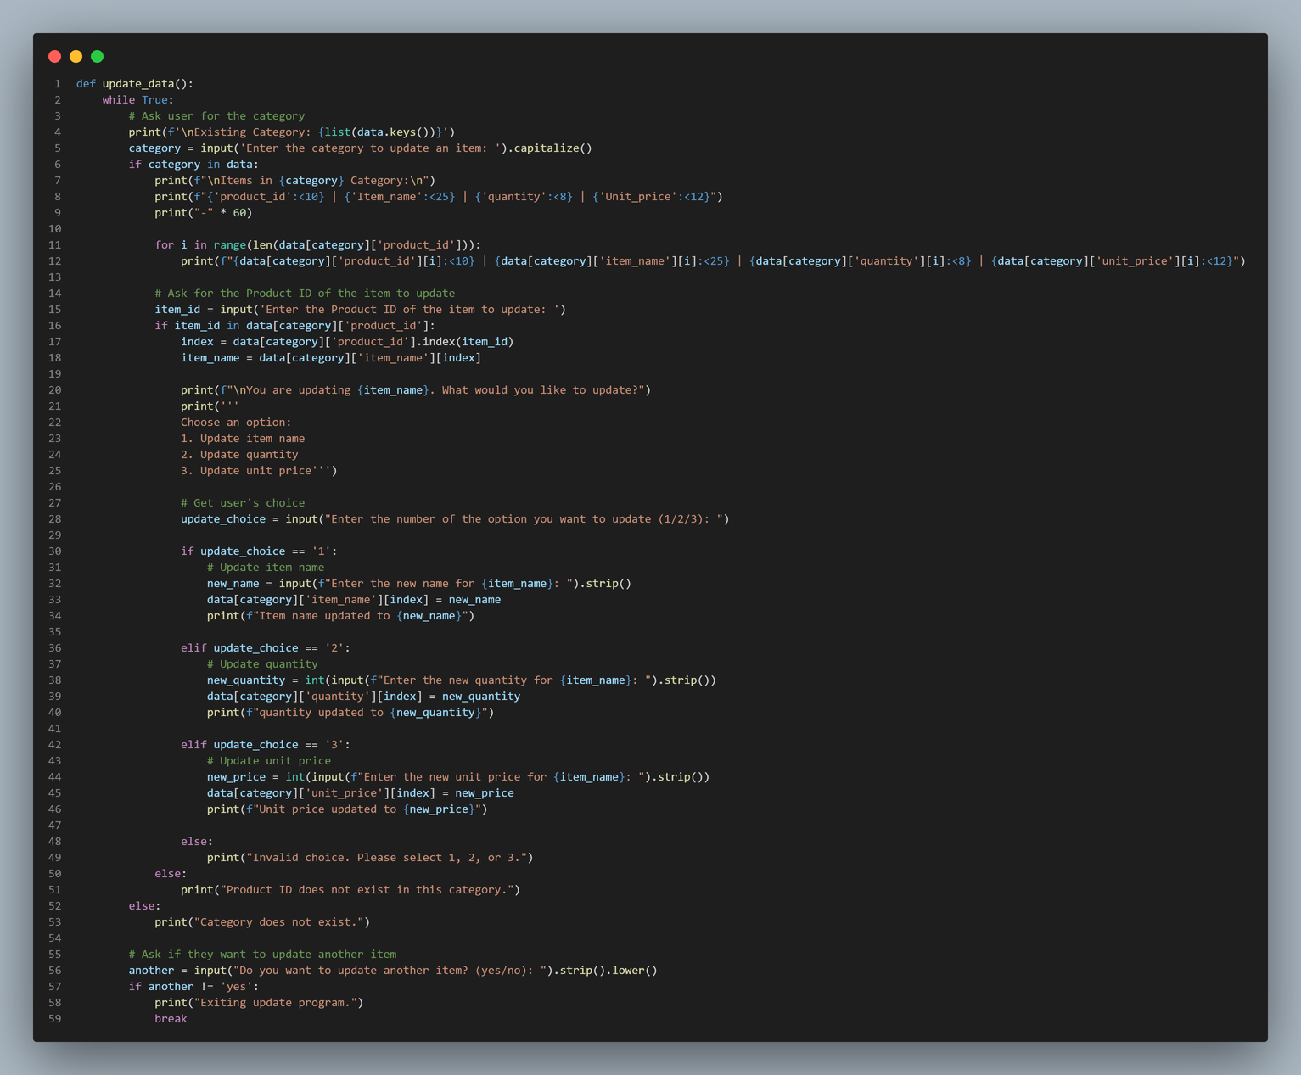
Update Data
Find the Item Name by do Indexing based on the item_id
Do the Update based on the choice:
If choice = 1, Then Updating the Product/Item Name
If choice = 2, Then Updating the Quantity
If choice = 3, Then Updating the Unit Price
Exit Scenario, By Asking If you want to update another item?

Slide 15
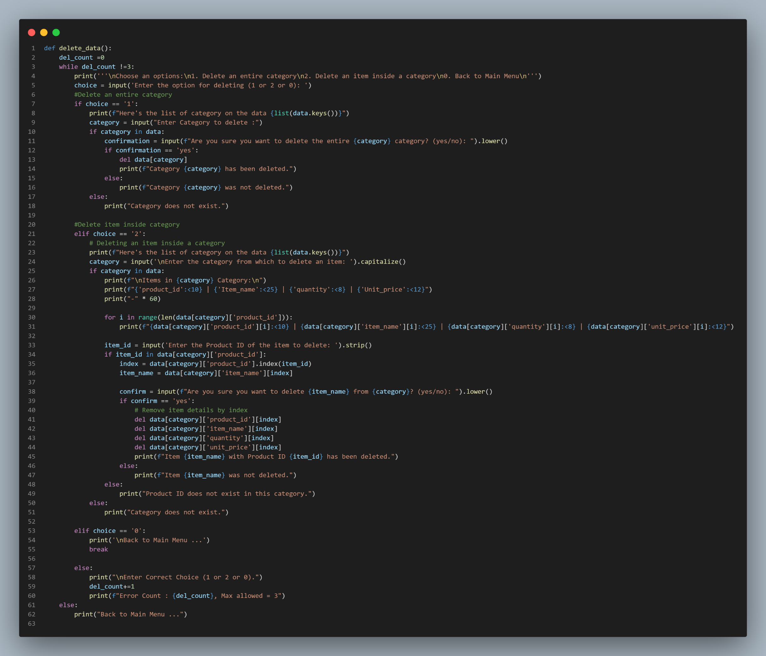
Delete Data
Choice 1: Delete an Entire Category
Input the specific category to delete.
Check if the category exists in the data.
Confirm the deletion of the category.
Delete the category if the confirmation is "yes."
Choice 2: Delete an item inside Category
Input the specific category.
Input Specific item to delete
Check if the item exists in the data.
Confirm the deletion of the category.
Delete the category if the confirmation is "yes."
Exit Scenario:
Type 0 to return to the main menu.
If there are 3 times mistypes, admin will be automatically returned to the main menu. A counter will add by 1 for each incorrect input.

Slide 16
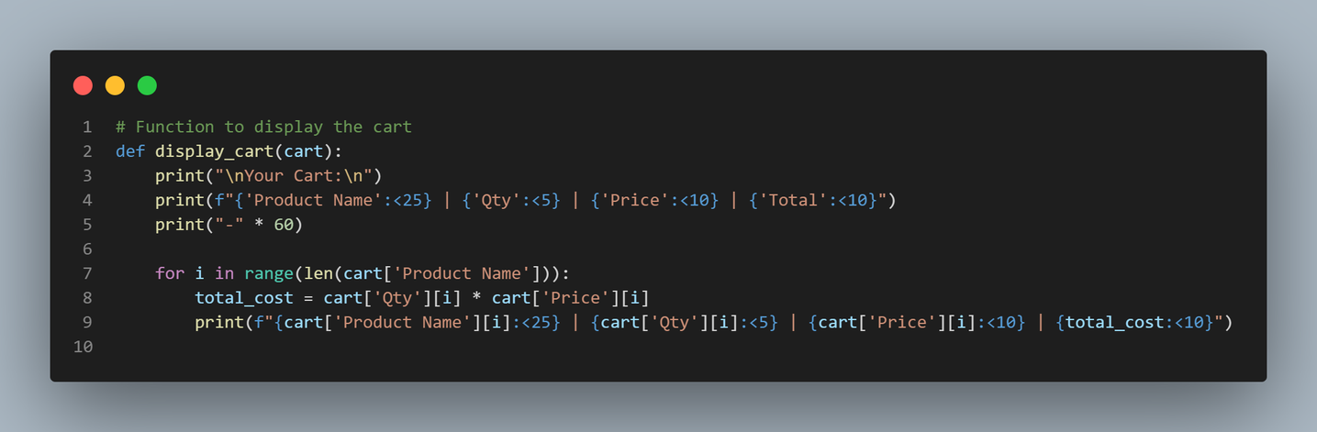
Display Cart
Display Cart using for Loop, because It allows user to display all the items and their details contained within.
Use the syntax {variable: < intNumber} to format and display the items in a tidy manner.

Slide 17
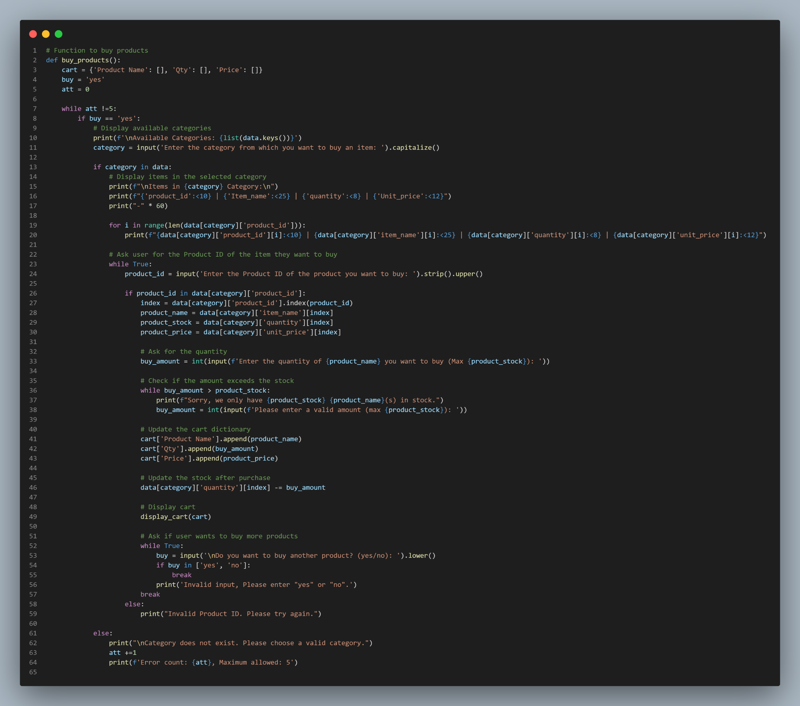
Purchase/Buy Product (1)
Buy Product:
Prompt the user to select a category for purchase.
If the category exists in the data, display the corresponding products. Otherwise, inform the user that the category does not exist.
Ask the user to enter the desired quantity of the product.
Check if the requested amount exceeds the available stock:
If it does, prompt the user to enter a valid amount.
If it’s less than or equal to the stock, add the product to the cart dictionary and reduce the quantity from the stock.
Stop Purchasing Scenario:
User will be asked If want to buy another product or not
If Yes, It will do the code above
If No, It will go to payment process
Stop Scenario using Counter on att variables

Slide 18
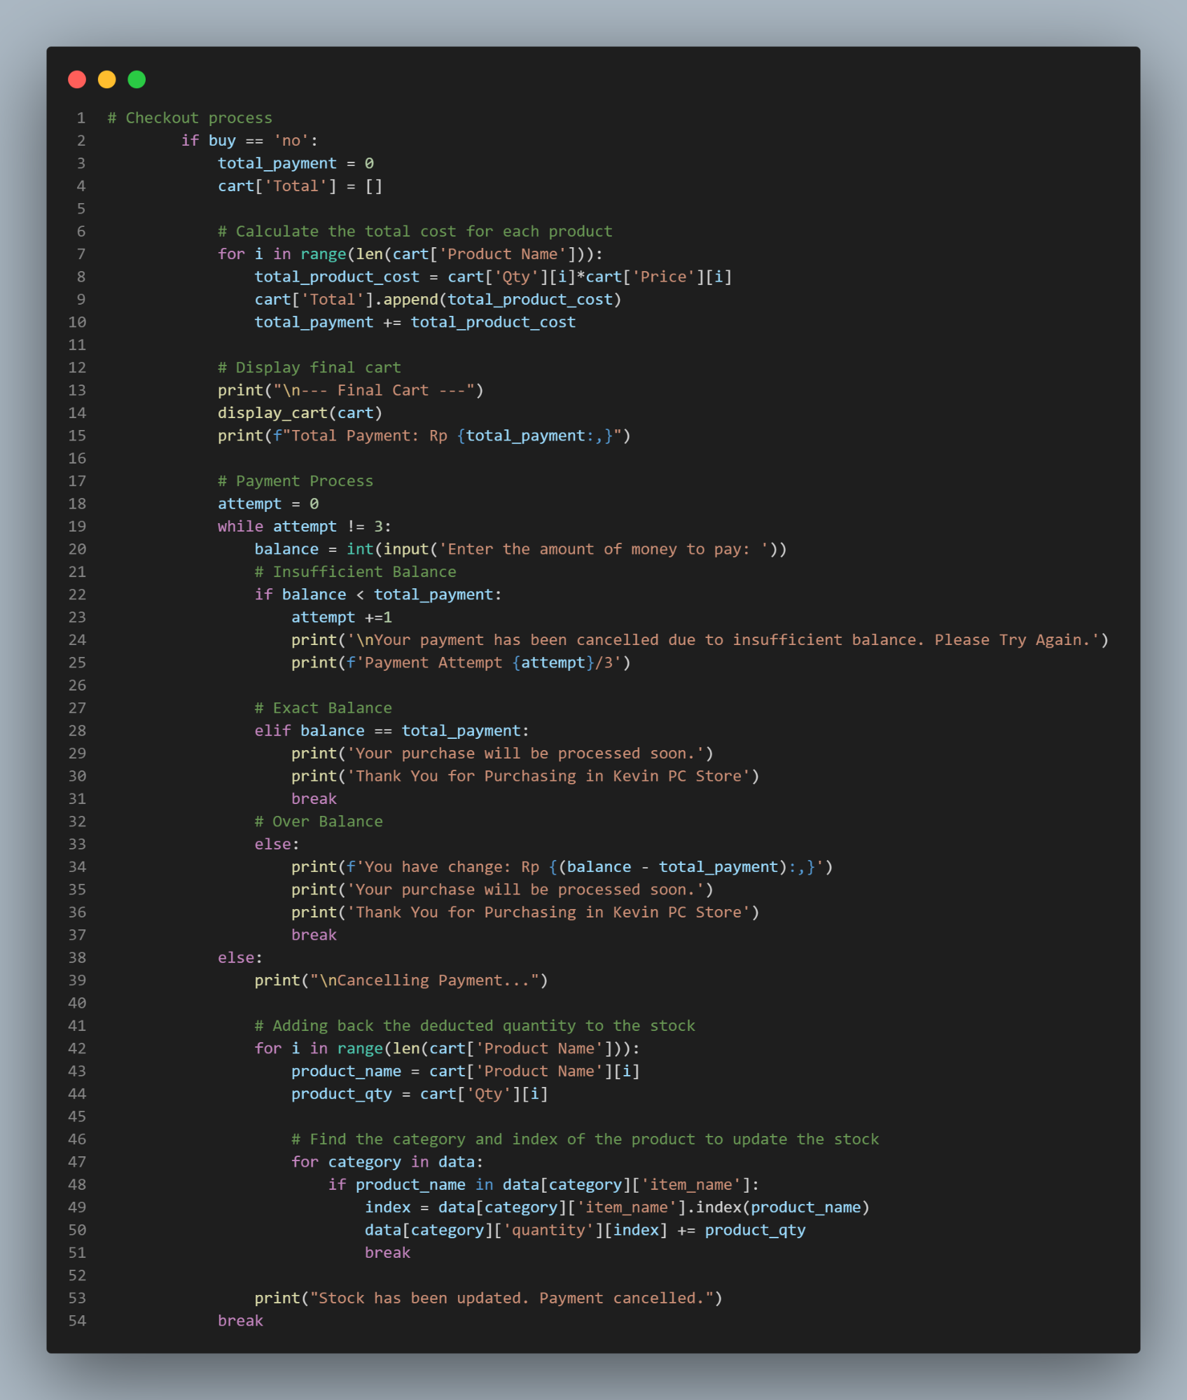
Purchase/Buy Product (2)
Display Cart Data, by executing display_cart and use cart dictionary as input
It will display the total amount of the cart, So user can easily know the total amount they should pay
Payment Process Features:
User needs to input the balance, the program will automate check if the balance is over, equal, or insufficient
If balance Over or Equal than total cart, It will end the program
If Insufficient balance, the user should enter the balance again with max attempt is 3 times

Slide 19
LETS DO THE SIMULATION

